Slide 1


NHS Mental Health App – Initial Client Meeting

Slide 2

Introduction
About the Project:
The NHS Mental Health App is a digital platform designed to provide accessible, reliable, and innovative mental health support to Gateshead residents.
Purpose of the Meeting:
This meeting aims to present our project concept, discuss the development process, and gather valuable feedback from the client to align with their expectations

Slide 3
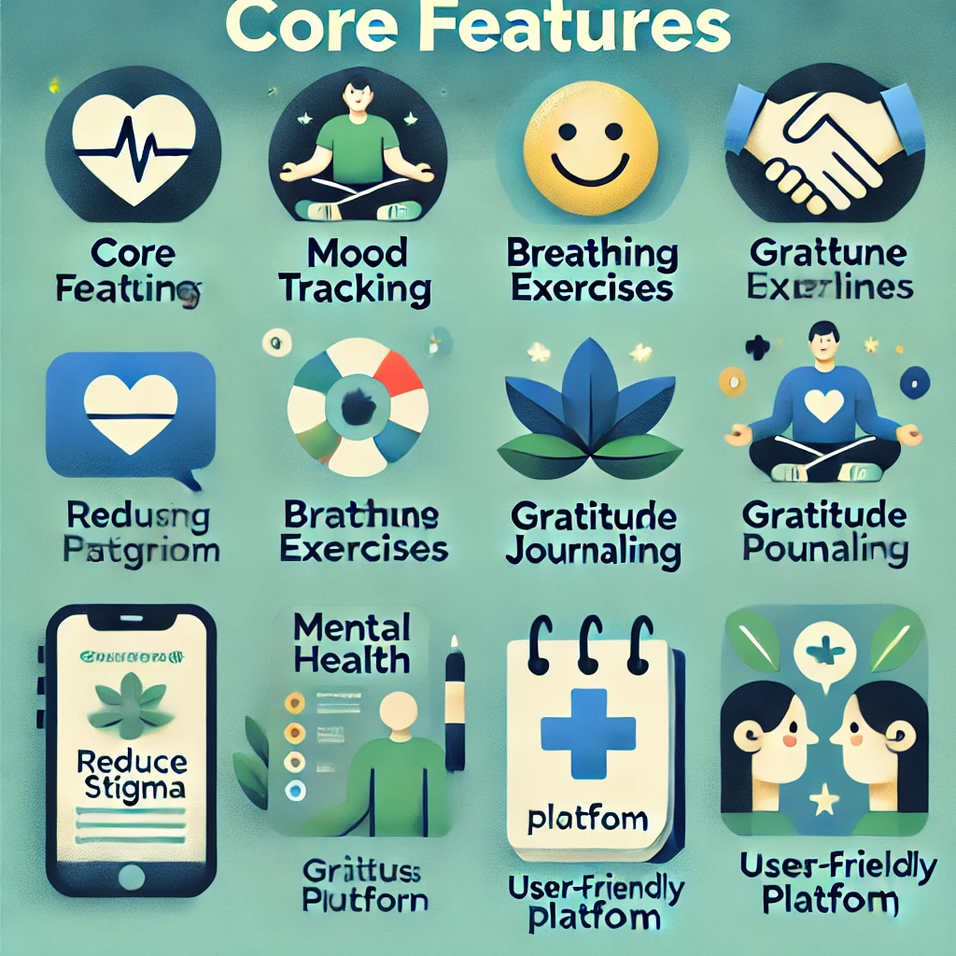
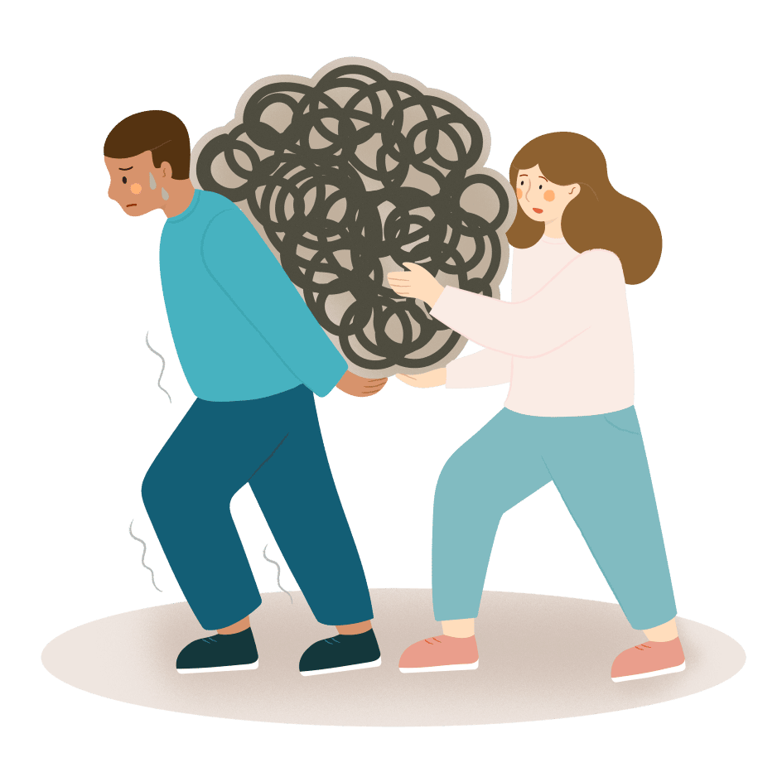
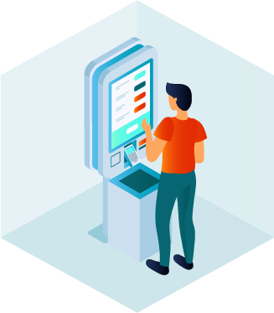

Key Highlights:
Core Features:
- Mood tracking.
- Breathing exercises.
- Gratitude journaling.
- Crisis support.
Objectives:
- Reduce stigma surrounding mental health.
- Provide a user-friendly and interactive platform for self-care.
- Ensure accessibility for users with an average reading age of 8–10 years.

Slide 4

Meet the team

Slide 5

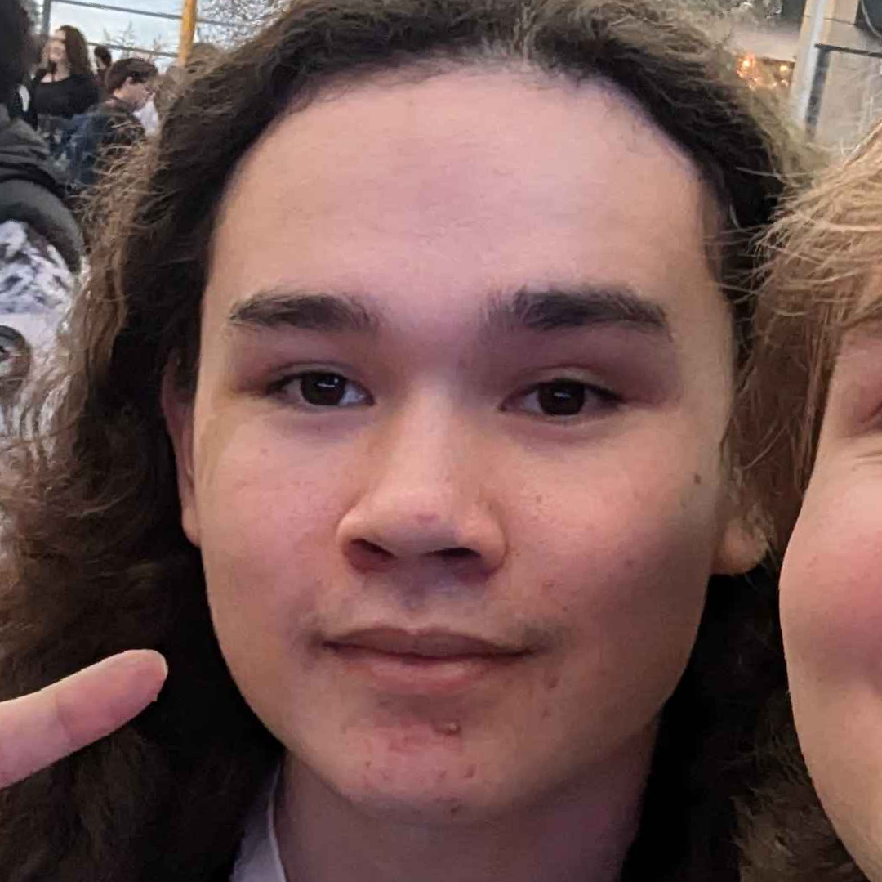
Lead Project manager
Jeremy Ryan Garside

Slide 6

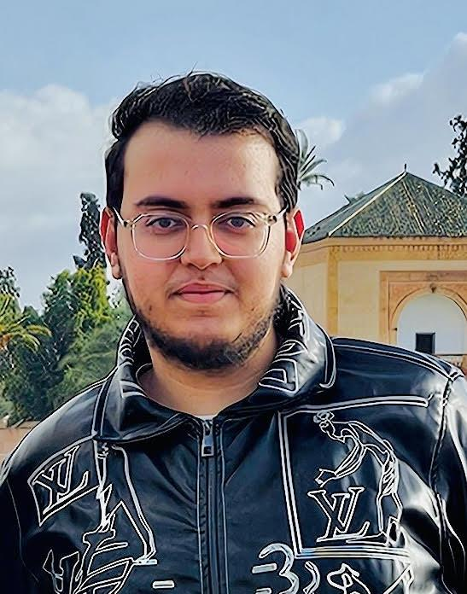

Marketing Team
Walid Graihim
Zaham Haider

Slide 7
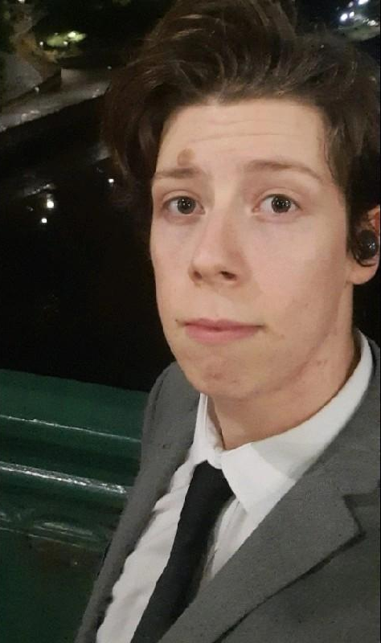

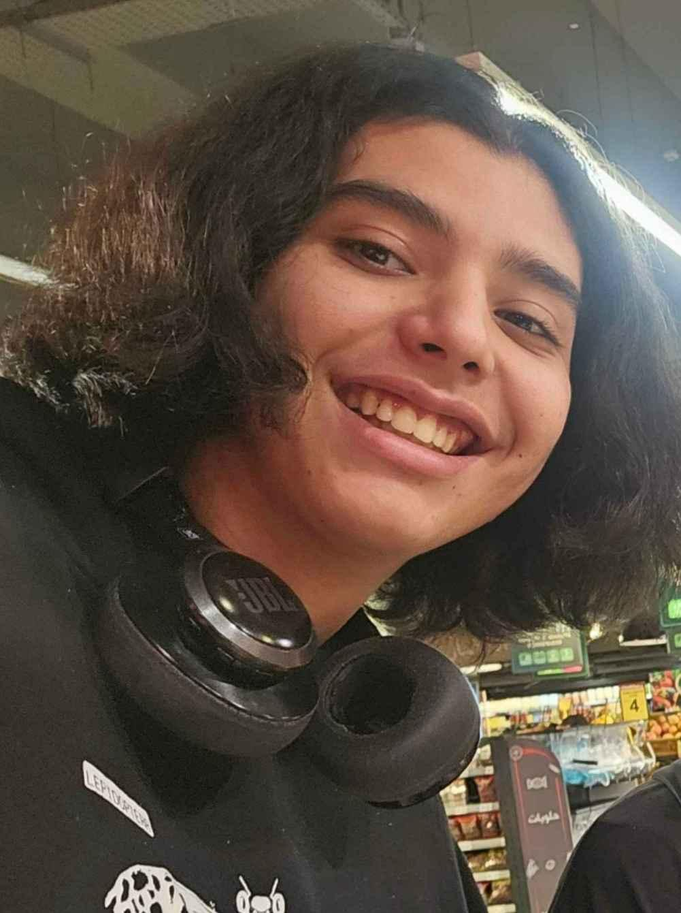
Development Team
Development leader
Developer
Cameron Haynes
Haytham Grari

Slide 8

Art/Design Team
Jeremy
Tony

Slide 9

Initial Proposition
01

Slide 10
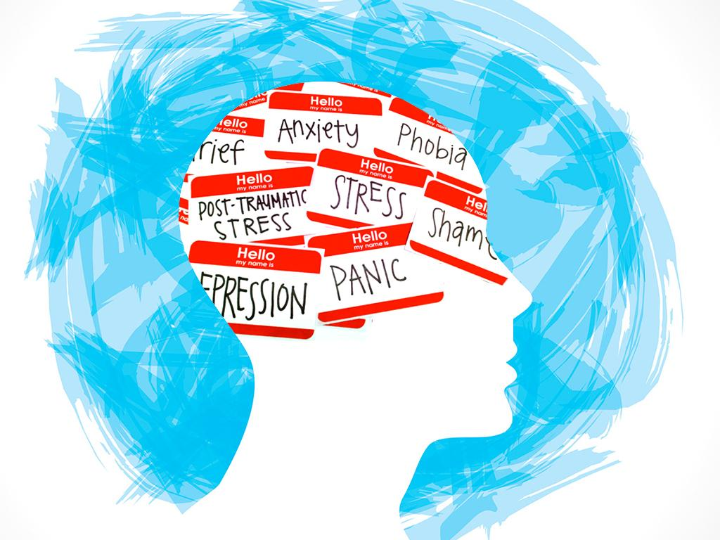

Web App Functionalities
Mood Tracking Page – Users log daily moods, track patterns, and gain insights.
Mental Health Activities & Articles Read small articles on meditation, mindfulness, and stress relief. Earn in-app currency to unlock rewards.
Tamagotchi/Pet-Keeping Game – A virtual pet designed to help users relax and manage stress through interactive care.

Slide 11
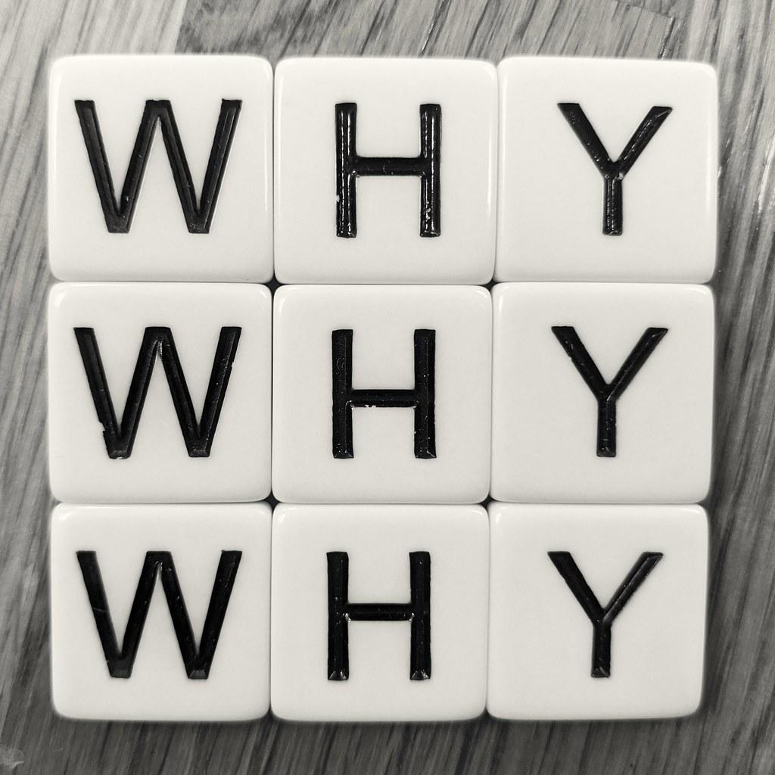
Why Have We Chosen This As A Project?

Slide 12
It has been shown that caring for pets does significantly increase quality of life for both healthy and mentally ill patients
Keeping track of people’s mood and keywords allows for better recommendation of methods for managing or keeping moods high
This is linked with the recommended articles page which may be influenced by reports from the mood tracker
Scoresby KJ, Strand EB, Ng Z, Brown KC, Stilz CR, Strobel K, Barroso CS, Souza M. Pet Ownership and Quality of Life: A Systematic Review of the Literature. Vet Sci. 2021 Dec 16;8(12):332. doi: 10.3390/vetsci8120332. PMID: 34941859; PMCID: PMC8705563.

Slide 13
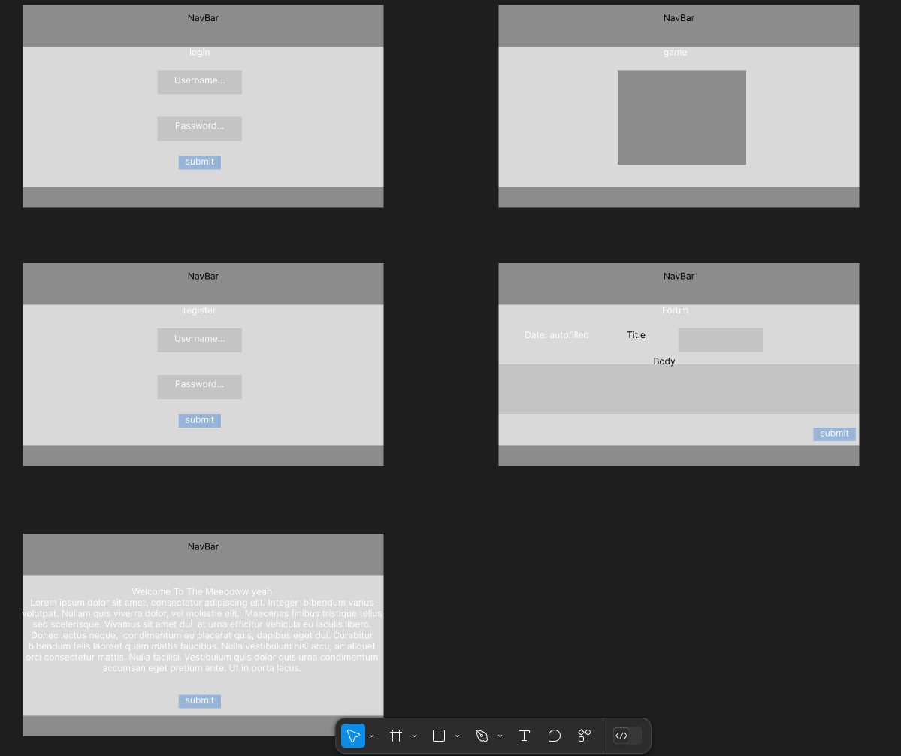
Website Prototype

Slide 14
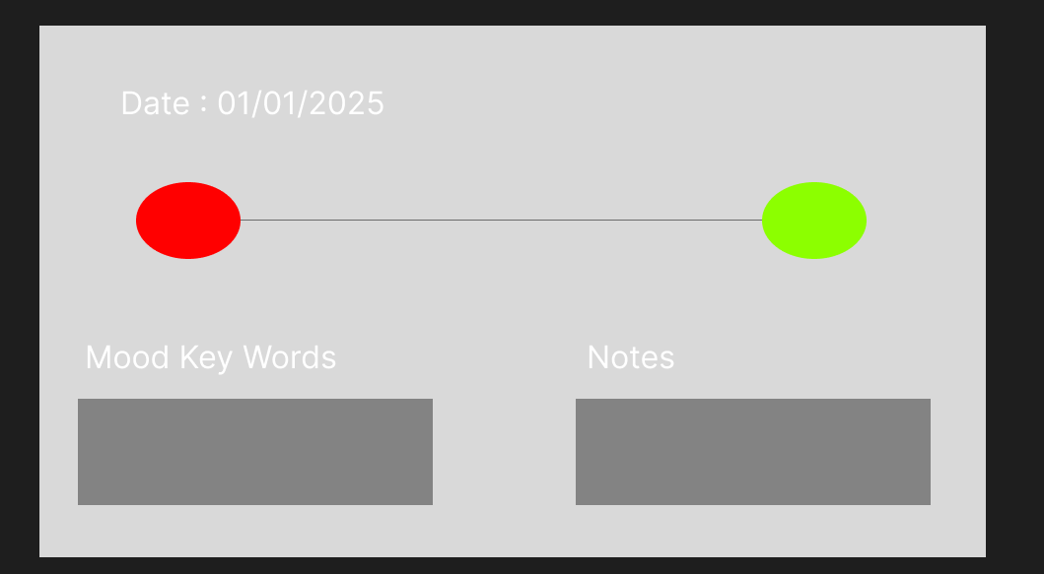

Slide 15
Live Demo
Login System Developed through to database that will be able to store player progress and any mood tracker data
The website is build on the React framework with and ExpressJS API (allows the website to talk to the database) with a SQLite database

Slide 16

Any Questions?

Slide 17

Any questions from us?

Slide 18
Based on our prototypes are there any features you can see being changed or added?
Is there a specific user interaction you have in mind ?

Slide 19
Any design preferences for the company (eg, stick to house identity) ?
Must haves for the software , what do you see as crucial for the success of the prototype?

Slide 20

Would you like to ask any questions or clarify anything?

Slide 21
End of Presentation
Presentation made by : Walid (Marketing)

